Slide 1
Using 'Dotnet Tools' to create Reusable and Shareable Tools and Applications
Rick Strahl
West Wind Technologies
west-wind.com
Weblog.west-wind.com
Session materials:
github.com/rickstrahl/dotnetcoretools-presentation

Slide 2
“A Dotnet Tool is really like a glorified .NET Core Console Application that can be easily shared and installed via NuGet.”
Me, 2020

Slide 3
So Really… What’s a Dotnet Tool?
An easy way to Share .NET Core Binaries
Allows distribution of binary Console Applications
Uses NuGet for publishing and consuming
Cross Platform – goes anywhere .NET Core goes
Shareable User Created Tools
Easy to Create
Easy to Publish
Easy to Consume
Easy to Update
Quick to Uninstall
Requires .NET Core SDK
Not a generic Package Manager
Requires .NET Core SDK to consume

Slide 4
“Did you just describe NPM?”
Yup! Dotnet Tool is like NPM for .NET Core.
Me, 2020

Slide 5
Binary or Dotnet Tool?
Dotnet Tools are easy to Share
You can easily install a dotnet tool through the SDK
Easily share across the organization or the Internet
Dotnet Tools are Platform Agnostic
Dotnet Tools can run cross-platform
No separate binaries required for each platform
Dotnet Tools have small Distribution Size
Only the Application Binaries need to be Distributed
Binaries can be Self-Contained
Binaries can be built with everything they need to run

Slide 6
What it’s good for?
Build and Dev Time Tools
Original design goal was for project helpers
Example: dotnet ef tools Dotnet Tool
Example: dotnet watch (built in)
Generic Command Line Tools
Can be used for much more than dev tools
Generic Utilities: Converters and OS Tools
Shell Utils: Complex File Operations
Local Servers
You can run ASP.NET Core Servers Locally
Run SPA apps locally
Hybrid Applications - desktop UI running browsers

Slide 7
Dotnet Tools Infrastructure
.NET Projects
Projects can be marked as a tool
Uses <PackAsTool>
Dotnet Tool Command
Dedicated SDK Command to Install and Update

Slide 8
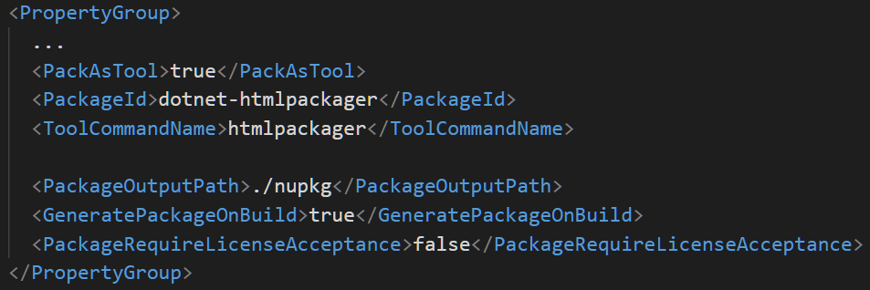
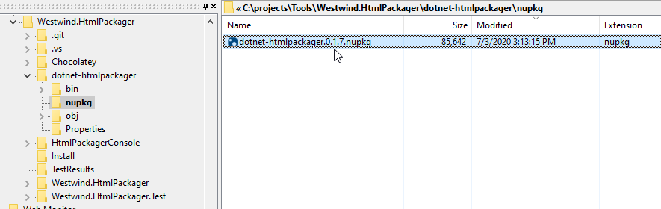
Creating a Dotnet Tool Project
.NET Project Property Group Elements
Builds a NuGet Package

Slide 9
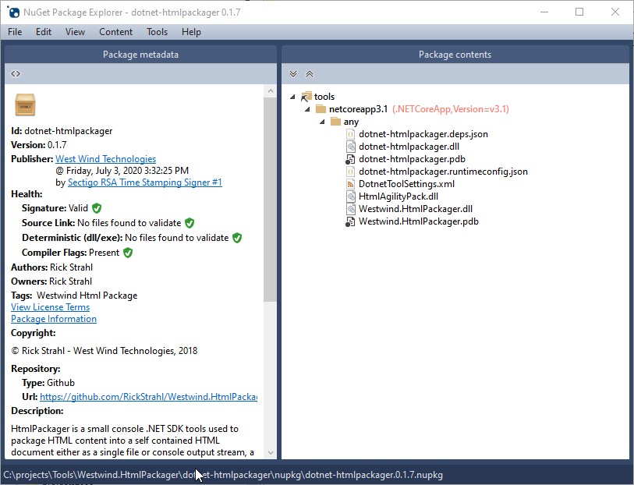
NuGet Package

Slide 10

An overview of .NET Core What is it, and should you care?
Rick Strahl
West Wind Technologies
www.west-wind.com
www.west-wind.com/weblog
Session materials:
https://github.com/RickStrahl/SWFOX2019_DotnetCore

Slide 11







Rick Strahl
Big Kahuna West Wind Technologies
Author and Speaker
Popular Blog: weblog.west-wind.com
ASP.NET Insider and MVP
Tools and Components
@RickStrahl
rstrahl@west-wind.com
weblog.west-wind.com

Slide 12
.NET Core: More than a FaceLift
.NET Core is different than Full Framework
Full Framework != .NET Core
Different integration and hosting mechanisms
.NET Core is not tied to Windows
Windows specific support is an addon framework (3.0)
.NET Core changes Everything
New platform paradigm for .NET
Cross Platform
100% Open Source
Command Line Tooling
Completely rearchitected infrastructure (under the hood)
Open source has created a very active developer environment
Version 3.0 is a Charm?
V1 was a very limited release
V2 brought back many features that were missing
V3 brings back more features, plus huge performance gains

Slide 13
.NET Framework is Done!
Full .NET Framework
Ships with Windows
Is Updated with Windows
Is used extensively by Windows Components
Great to rely on because it’s just there
Version 4.8 is the Last .NET Framework Version
Only bug and security fixes will be made
All future updates to CoreFx features will be only in Core
Will be supported indefinitely
It’s a Windows feature and won’t go away
Just no new features
Supports .NET Standard 2.0
Allows some interop with .NET Core

Slide 14
.NET as a Platform not your Granny’s .NET
Many .NET’s, Common Set of Tools
.NET Core, .NET Framework, Xamarin, Mono
All can share the eco system and for separate specialties
Microsoft has re-architected .NET
Common base CoreFx
Common Compilers and Build tools
Command line driven, available to all languages
Standard Libraries
.NET Standard defines a base set of features
.NET Runtimes implement .NET Standard version
Guarantees common feature set across .NETs

Slide 15
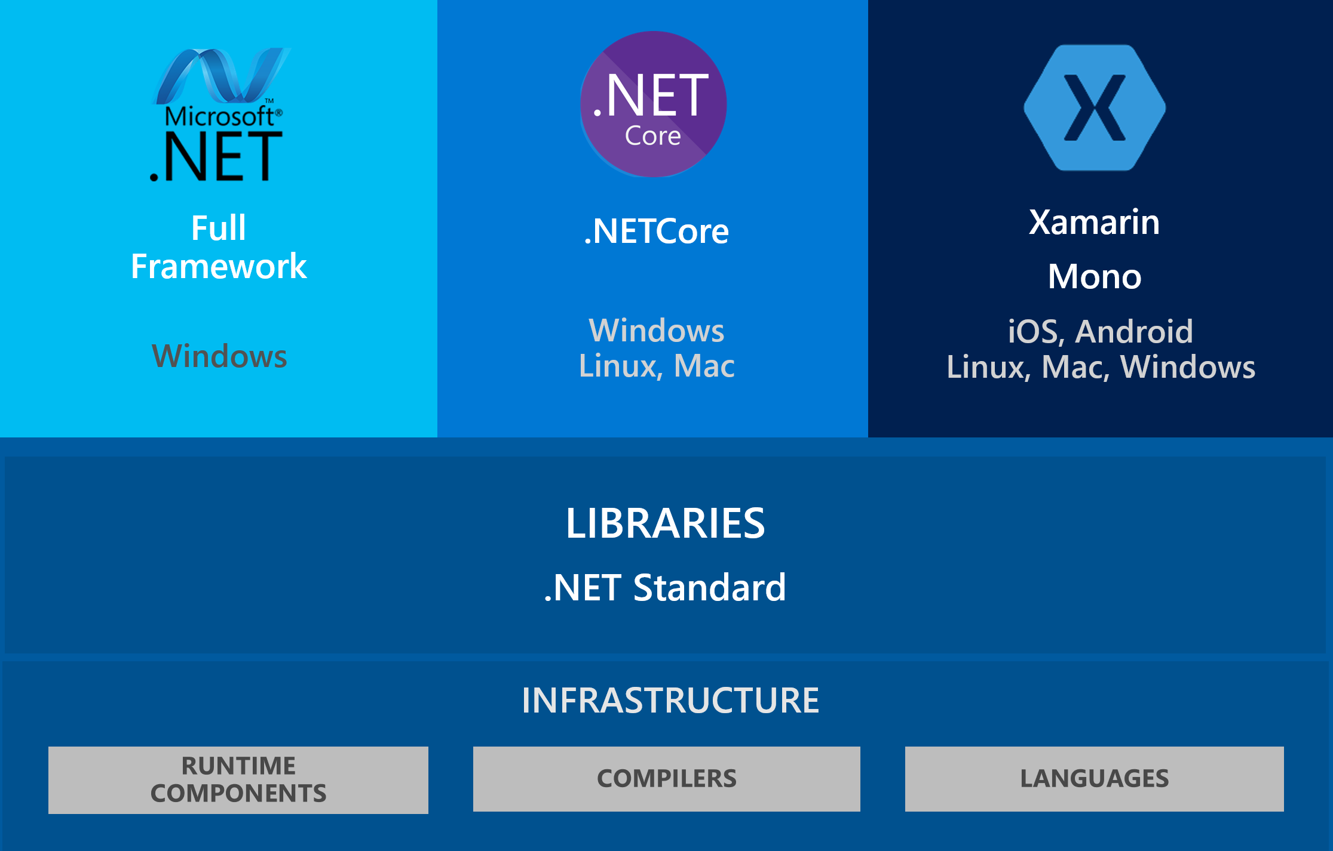
.NET as a Platform

Slide 16
.NET Feature Frameworks
Feature Frameworks sit ontop of Runtimes
ASP.NET for Web and Cloud Support
WinForms, WPF and UWP for Desktop Support
Xamarin for iOS and Android Mobile Apps
ML.NET for Machine Learning
Microsoft IoT Framework for devices
Frameworks are what make .NET Powerful
Frameworks can access all of the .NET base features
Applications are built ontop of Frameworks
Third parties can built new Frameworks

Slide 17
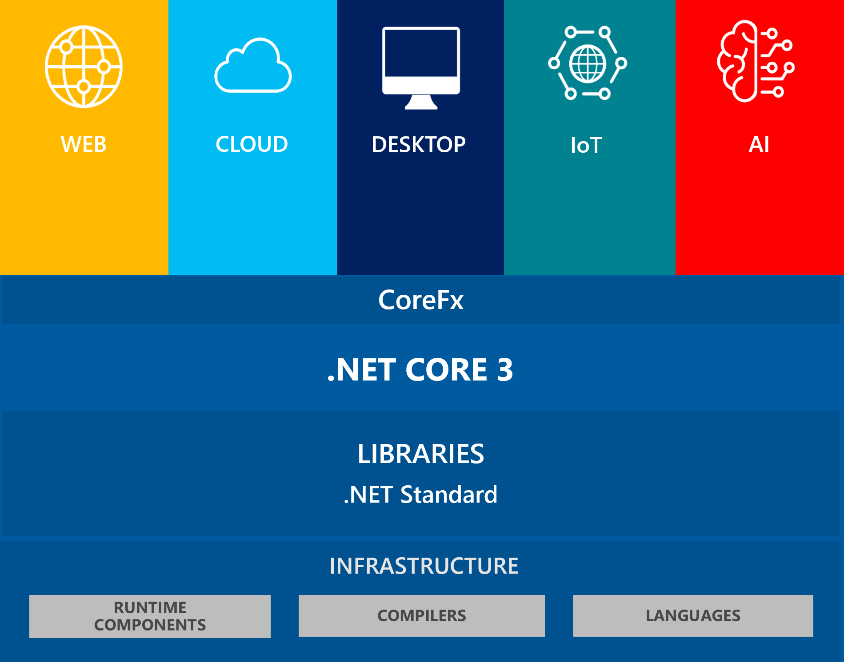
.NET Core 3.0

Slide 18
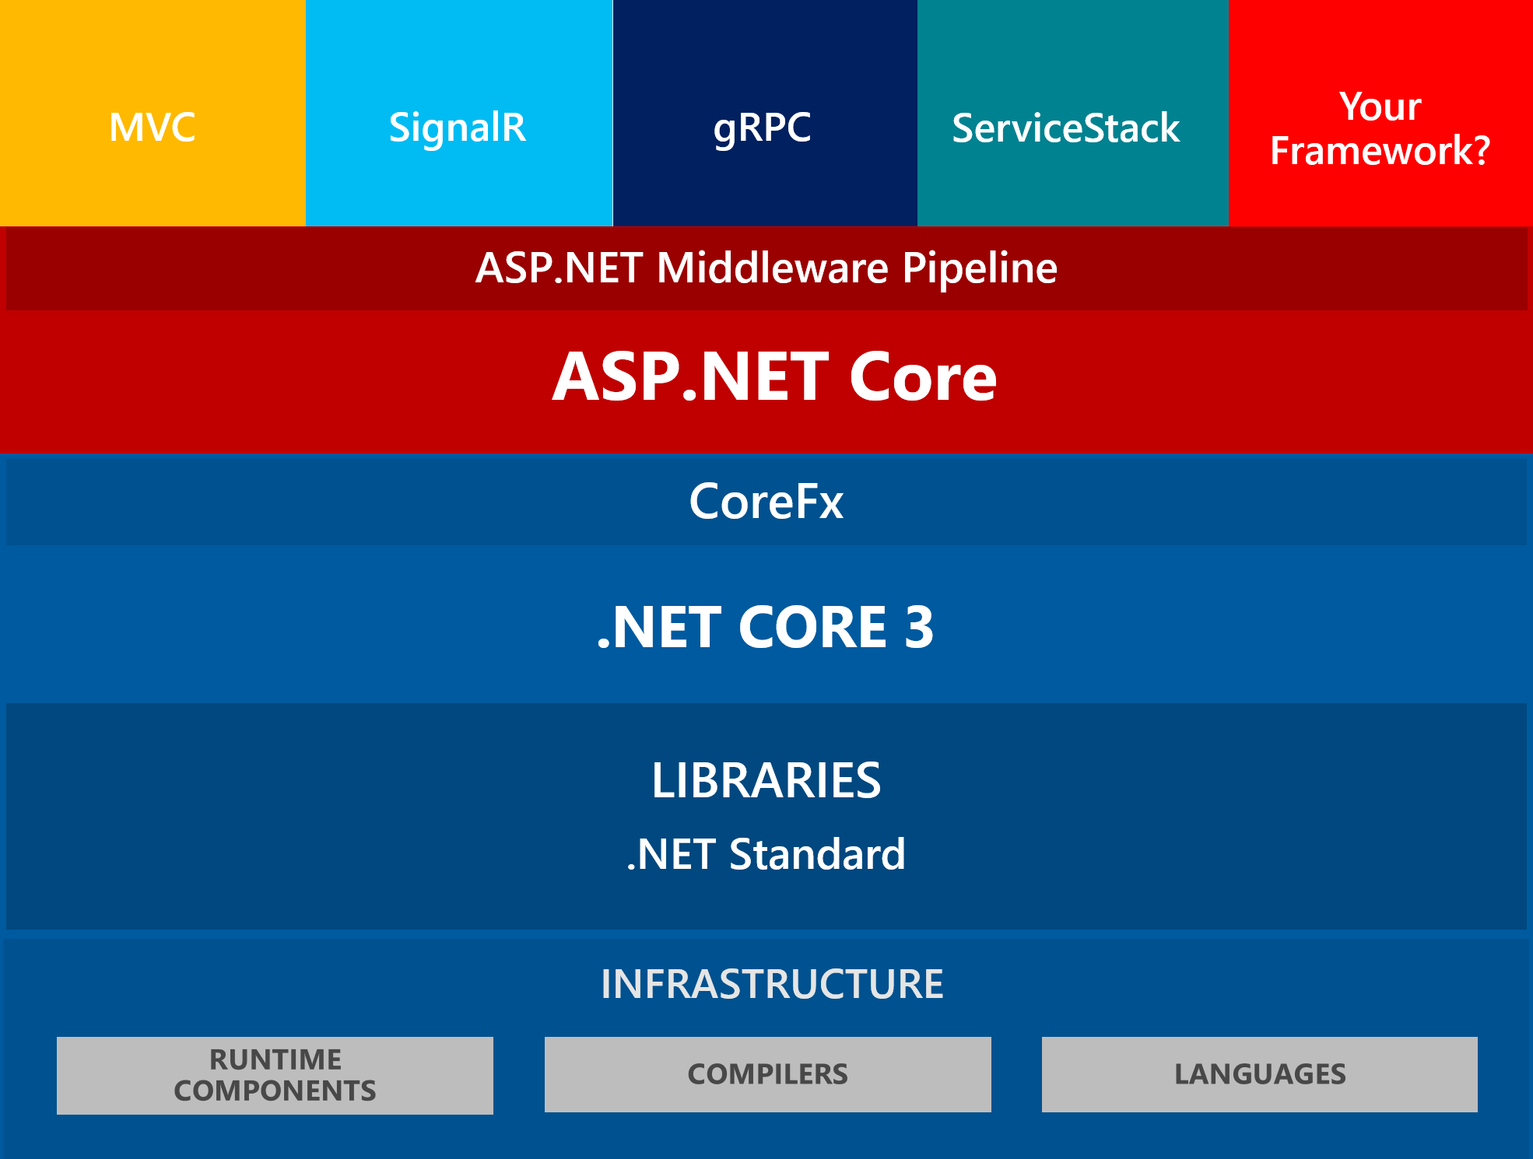
Frameworks within Frameworks

Slide 19
Tooling
Everything works from the Command Line
Dotnet command handles entire lifecyle processing
Compilation, Nuget Packages, Building, Publishing etc.
Developers can build custom tools (similar to NPM)
Can be Automated
Any application can call the compiler and build tools
It’s easy to hook build ops into your own applications
You can also build applications on the server
Or in a Docker Container
Extremely powerful compared to old MsBuild way
Custom Tools
Build your own Tools as a `dotnet tool`
Easily publish and share tools
Similar model to NPM for Node

Slide 20
Languages and Compilers
Unified Compilation System
Supports all built-in .NET Languages (C#, VB, F#)
Same tooling to compile all languages
Projects or individual files are supported
Command Line Tooling
You can compile using the `dotnet` command
Project determines the language to use
Raw compilers are also still available but shipped with Roslyn
Compiler as a Service
Roslyn is an API
Can be integrated into applications
Means: You can create your own compiling applications
Means: You can dynamically compile code at runtime

Slide 21
.NET Standard Libraries
.NET Standard is a BluePrint
A specification of .NET Features
A specific runtime implements that specification (ie. NetStandard 2.0)
It’s about Consistency
All frameworks now implement .NET Standard 2.0
Means: You get the same .NET features from that standard in all of the supported platforms.
Means: Vendors know EXACTLY what they have to implement
It’s about Compatibility
Standard forces requirements on library vendors
If a library supports .NET Standard 2.0 you know it works on any platform that supports .NET Standard 2.0

Slide 22
.NET Runtimes
Runtimes are Implmentations of .NET
Examples: .NET Core, .NET Framework, Mono, Xamarin, Unity
A runtime is a physical implementation of .NET features
Typically based on a specific version of .NET Standard
All frameworks now support .NET Standard 2.0
All frameworks EXCEPT full Framework are moving towards 2.1
System, IL Level services
Framework Functions
Runtime hosting
Bootstrapping of CoreFx
Assembly loading/Type Resolution
OS Integration semantics (ie. IO functions/OS features)

Slide 23
CoreFx
The .NET Core Feature Libraries
CoreFx provides the user API to the underlying runtime
Plus many common platform/language features
What used to be the BCL/FCL libraries
Contains the core .NET Platform features
IO/Reflection/Serialization/Math/Strings etc.
Most of the .NET Work happen in CoreFx
CoreFx is a very large surface
This is what most developers think of as .NET
It’s the core libraries that make up .NET features

Slide 24
Frameworks
Application Frameworks
ASP.NET MVC
SignalR
WindowsForms, WPF
Xamarin iOS/Android
Sit on top of the .NET Core Stack
This is where you get your work done
You create MVC or API Controllers in ASP.NET
You create a Windows or WPF form for Desktop
You create a gRPC service for services
You create a SignalR Hub
It’s the ‘application layer’
80% of your work is likely to happen at this level
The rest is Languages and Integration
Extensible
You can create your own Frameworks
Easy to do – use the same plumbing Microsoft uses
The cool thing is you get all the levels below for free!

Slide 25

ASP.net Core
the core of .NET Core

Slide 26

ASP.NET Core
ASP.NET is the 90% Use Case
Most used framework on .NET Core
Most of the investment is based around Web scenarios
Many new features are ‘dogfooded’ by ASP.NET Core
High Performance
ASP.NET Core is blazing fast compared to classic ASP.NET
Classic ASP.NET was limited by dependency on IIS
Native, very fast Kestrel Web Server
Custom server interfaces for platforms (.NET Core IIS Module)
Scores among top Web Servers for many scenarios (techempower)
Highest performance general purpose Web Application Server

Slide 27
What’s new in ASP.NET Core
High performance
Huge performance gains on already good performance
Drastically reduced memory footprint
Noticable in local development
Cross Platform
Important for Web apps
Host on Linux or Docker, and also Windows
Transparently switch between platforms
Middleware Pipeline
Powerful middleware pipeline to hook into Request lifecycle
Act on Before and After Processing handlers
Most features are hooked up as middleware
Examples:
Markdown Processing
Live Reload functionality
Custom encryption

Slide 28
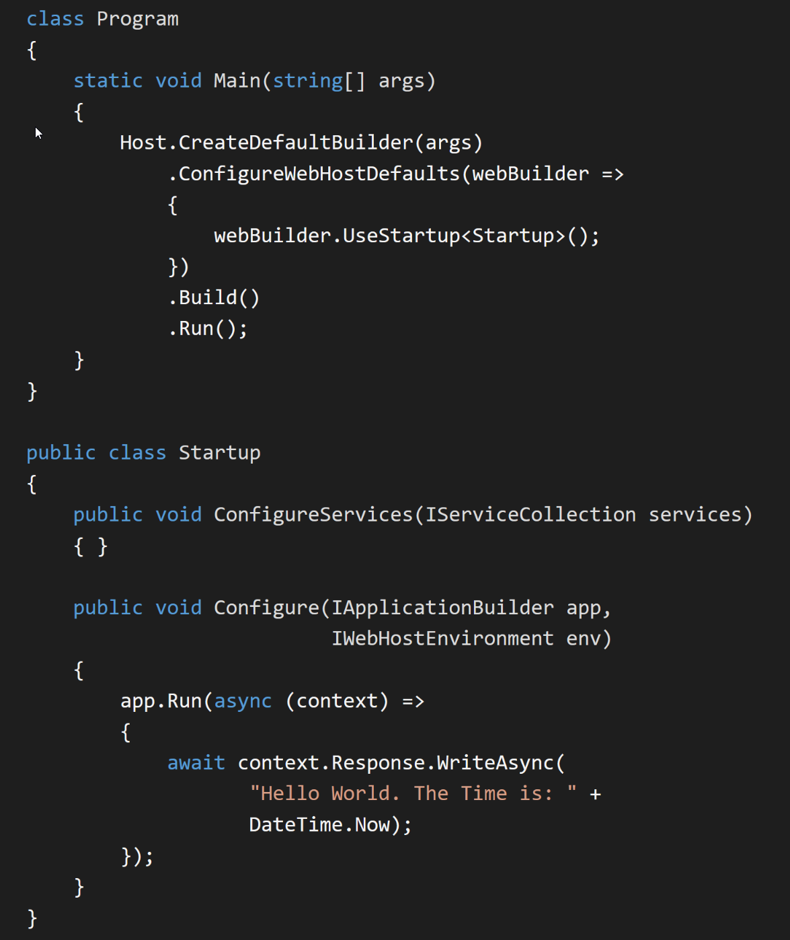
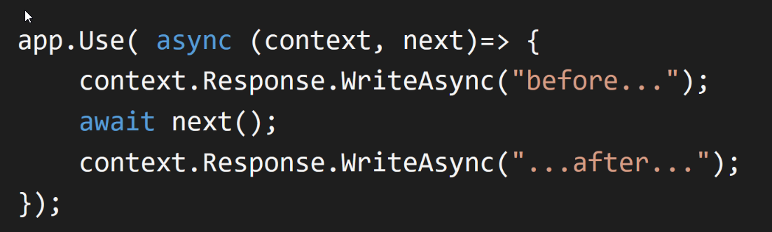
Minimal ASP.NET Core Application
Middleware

Slide 29
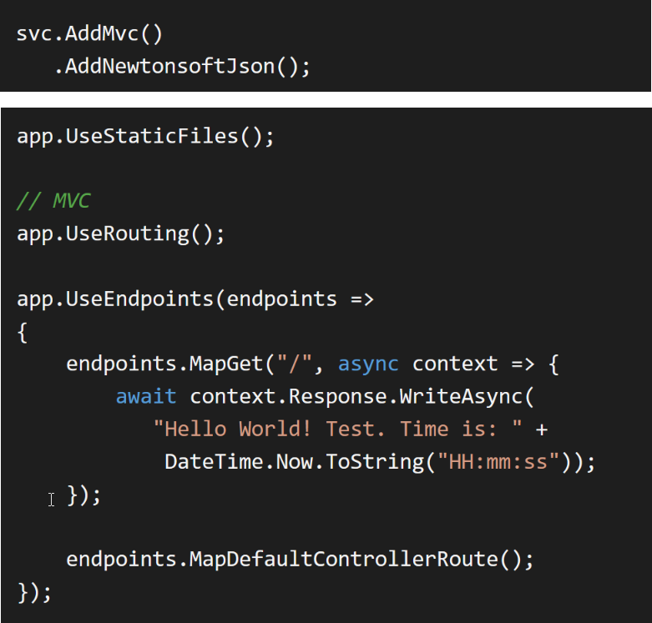
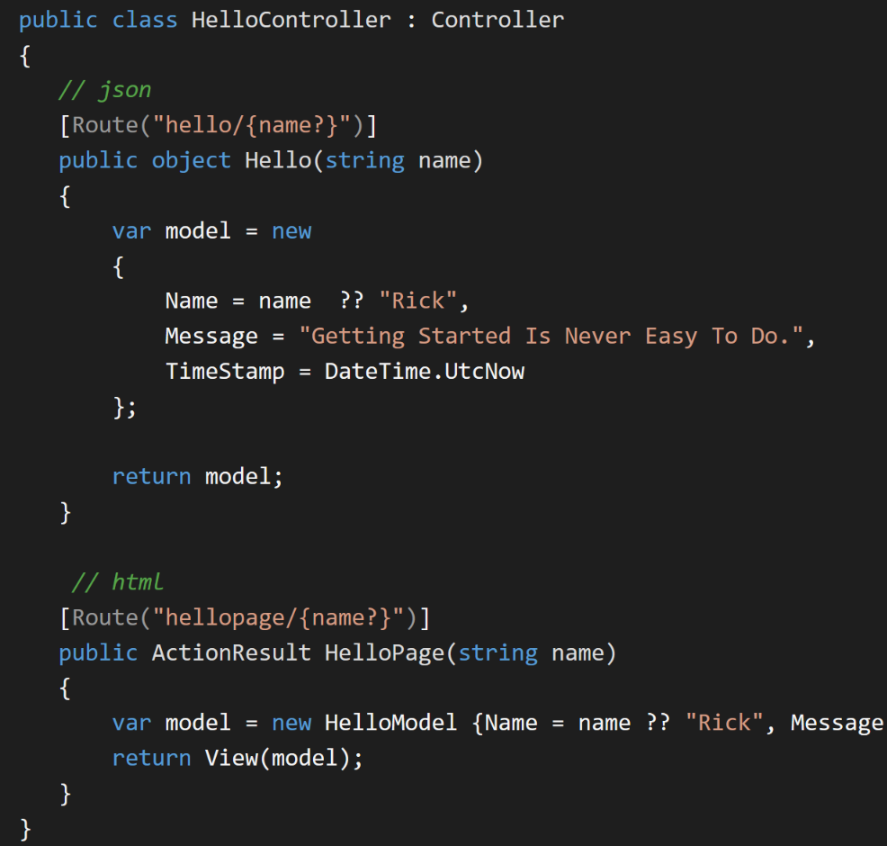
Endpoint Routing and MVC

Slide 30
Tools and Distribution

Slide 31
DotNet now has EXECELLENT Tooling
Build Tools via dotnet.exe
Restore and build applications
Run applications
Build Published Releases
Many build targets: Exe, Nuget Package, self-contained, shared
dotnet tool Command Tool
Easily installable local tools
Tools are installed onto global path
Tools are Console Applications
Can be servers, or just typical ‘tools’
Share your Tools via NuGet
Tools you create can be published as Nuget Packages
Installable via dotnet tool install
Powerful distribution mechanism

Slide 32
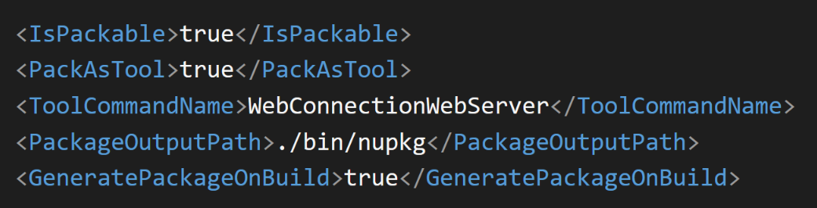
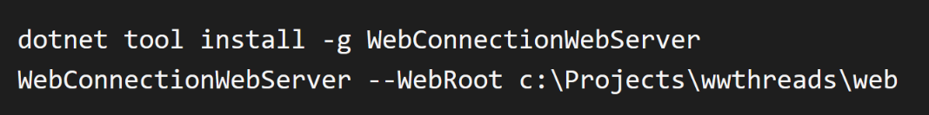
Share your Tools
Create Custom Tools
Build Console Applications
Build Web Servers
Add Project Tags
Produces .nupkg to publish to NuGet
Share your Tools via NuGet
Tools you create can be published as Nuget Packages
Installable via dotnet tool install
Powerful distribution mechanism
Install from anywhere with dotnet tool install

Slide 33
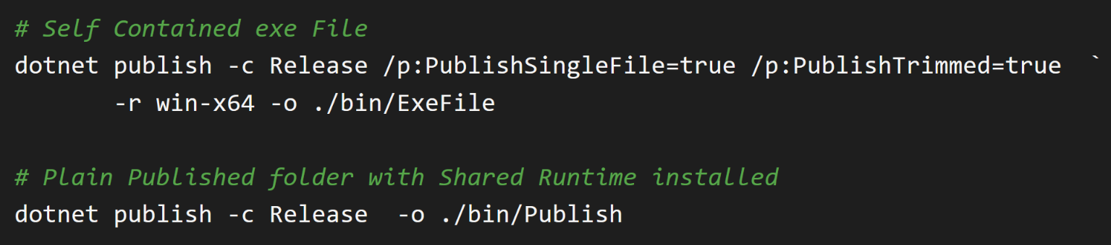
Distribution of .NET Applications
Shared Runtime Builds
Default build type
Requires that .NET Core Runtime is already installed
Version roll forward within major version
Self-Contained
Packages all files into a single folder or EXE
Includes .NET Runtime
Can create single File EXE
File is very large (40mb for hello world, Web Connection Server is 90mb)
You can trim – cuts size in half but risky
Publish to build Final output

Slide 34
Desktop Frameworks
Wpf and WinForms

Slide 35
Desktop Applications in .NET Core
New in .NET Core 3.0
Previously only Console Apps could run
By default all Console apps are cross platform
WinForm and WPF apps are Windows only!
Support for WinForms and WPF
Winforms and WPF SDKs can build desktop apps
Some differences in feature and a few missing features
Overall relatively easy to port an application to .NET Core
Windows Platform Support
Windows specific features aren’t part of .NET Core
Added via special support libraries that provide Windows features
Note: Most but not all Windows features are supported

Slide 36
Pros and Cons for .NET Core Desktop Apps vs. Framework Apps
Pros
Cons
Self contained installations
Your app is fixed and not updated by OS
Performance improvements in .NET Core
Future proof
Microsoft enhances .NET Core
Future performance gains
Open sourced WPF/WinForms might bring improvements of long neglected Frameworks
No OS pre-installed runtimes
Runtimes are large (~50mb)
A few missing Windows features

Slide 37
FoxPro and .NET Core
Interop is more complicated

Slide 38
FoxPro and .NET Core
Different Hosting Model
New Runtime Hosting APIs
New COM Host
But no IDispatch support
FoxPro -> .NET
Plain COM Interop instantiation no longer works
But wwDotnetBridge now works with .NET Core
Most features are supported
.NET Core -> FoxPro
No easy ASP.NET Core Support
No native support for STA Threading
Requires a custom implementation
Web Connection can now run as .NET Middleware

Slide 39
Calling .NET Core from FoxPro
Built-in Idispatch COM Interop is Dead
Standard COM Invocation no longer works in .NET Core
IDispatch is currently not supported for .NET Core COM Objects
Not likely to be supporte in the future
wwDotnetBridge works
New wwDotnetCoreBridge class
Allows invocation of .NET Core classes
Otherwise works the same as full framework version
Access to most features is available
wwDotnetBridge Limitations
Can’t unload .NET Runtime once loaded
No easy way to load framework libraries (AspNetCore/WinForms/WPF)
CLEAR ALL/RELEASE ALL will kill the .NET Core Runtime
Fine for Production Applications
Problematic at Dev time if you RELEASE environment

Slide 40
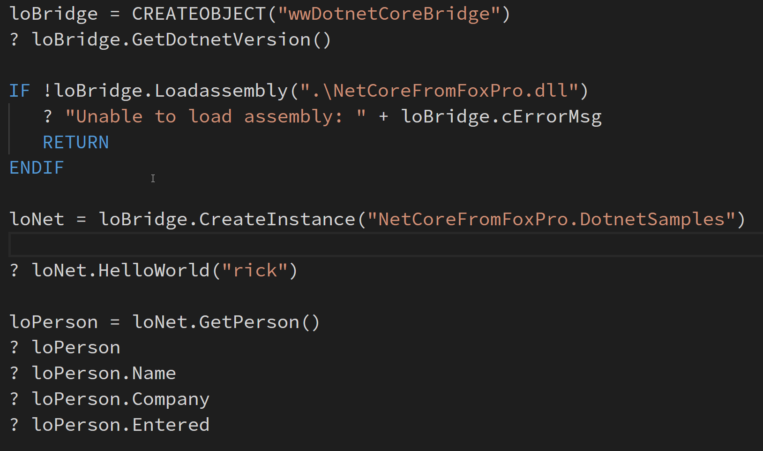
Using wwDotnetCoreBridge

Slide 41
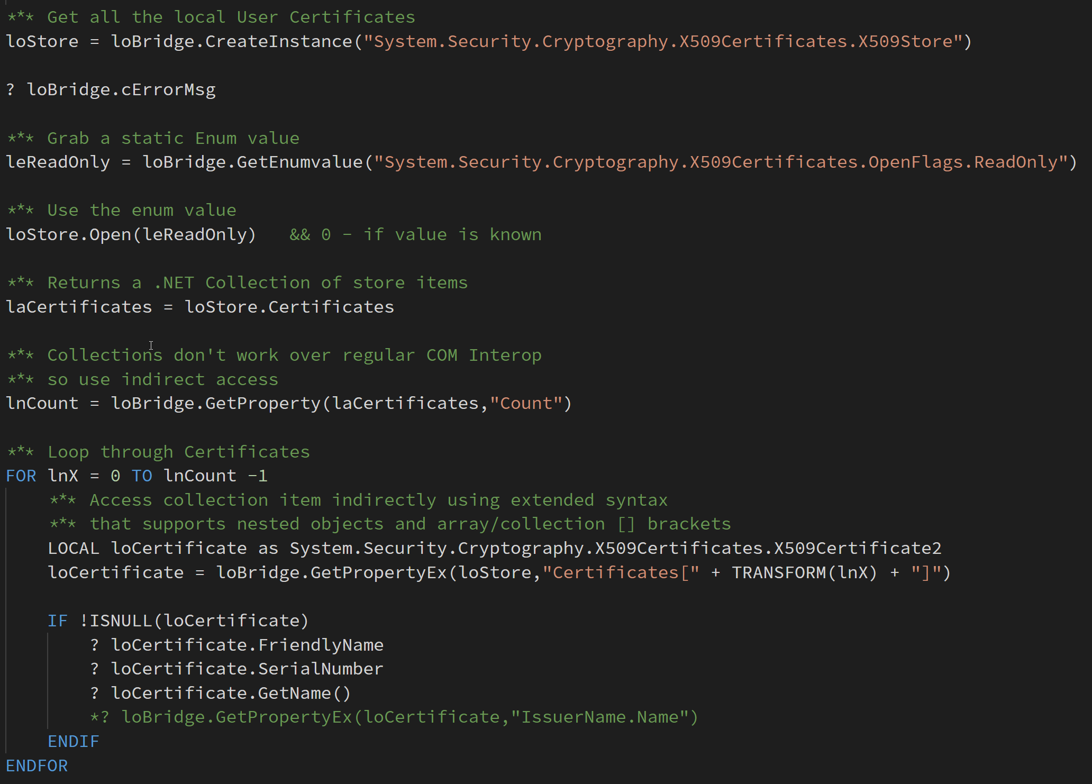
Using wwDotnetCoreBridge

Slide 42
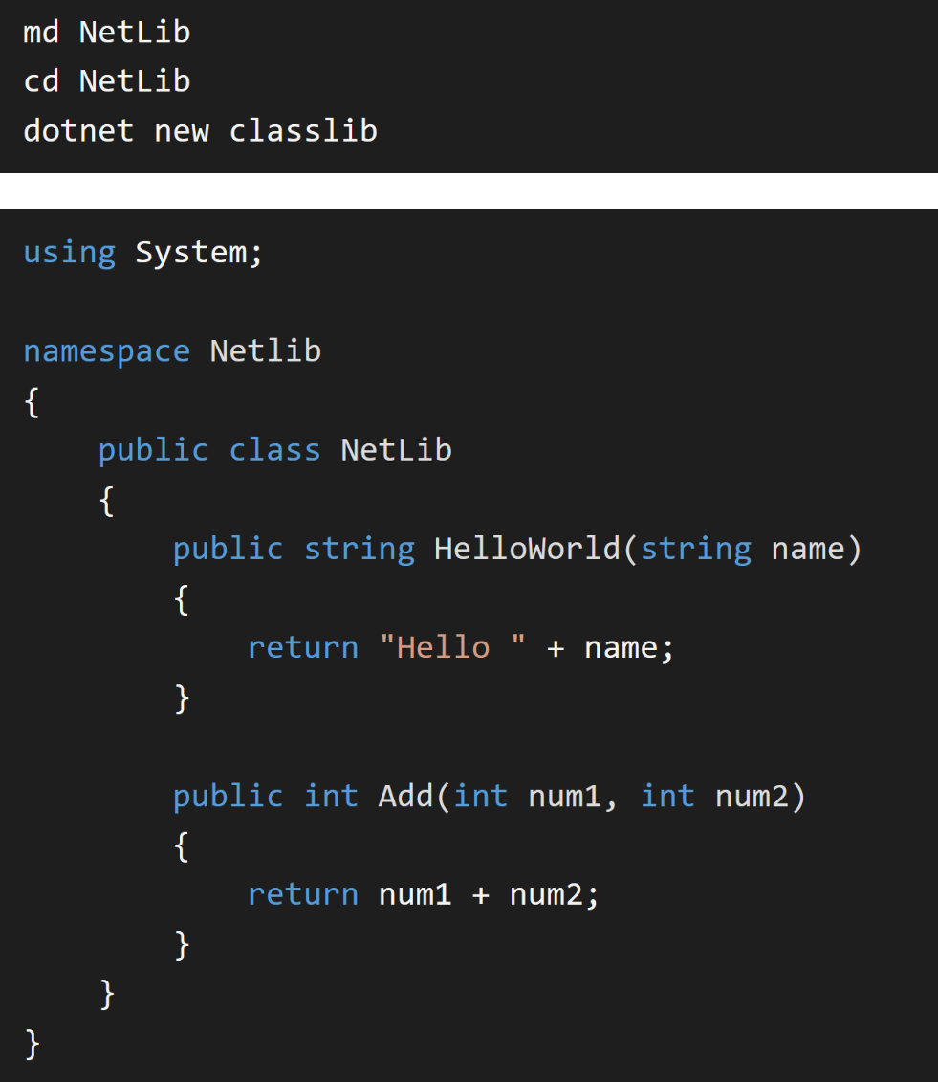
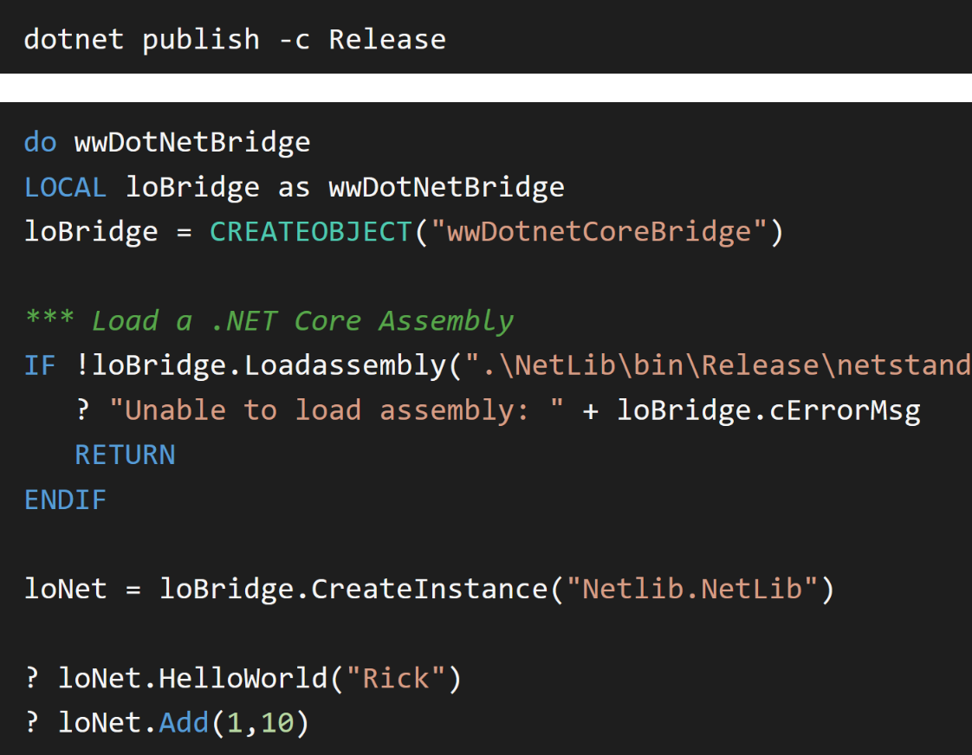
Create a ClassLibrary and Call it

Slide 43
ASP.NET Core and FoxPro
No STA Thread support in ASP.nET Core
Web Server uses MTA Threads
Web Server is heavily using Async code
FoxPro COM Servers require STA threading
MTA threads will corrupt FoxPro Server State
COM is supported, but…
In ASP.NET Core it requires a custom Thread pool
No native support for that is available

Slide 44
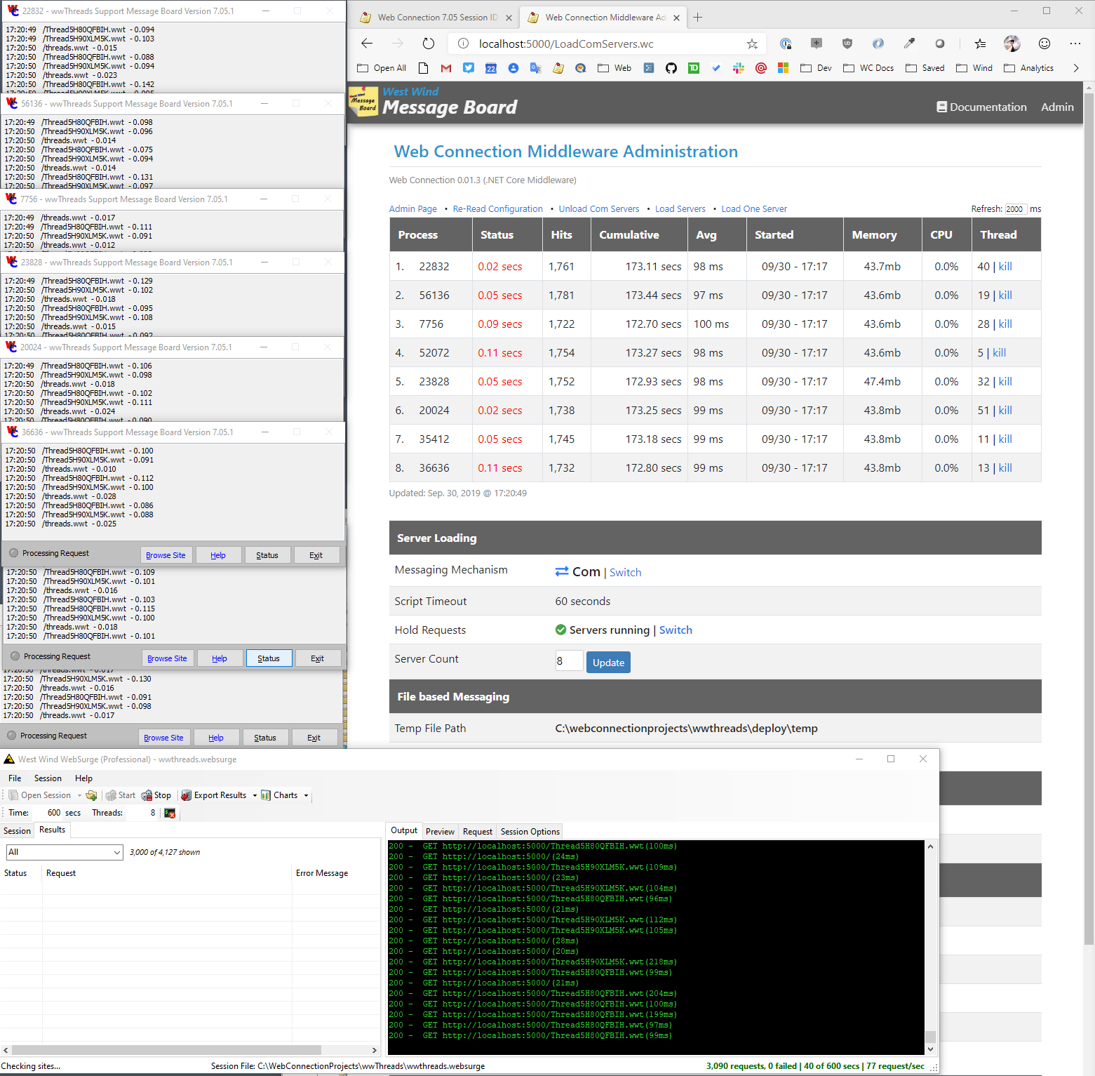
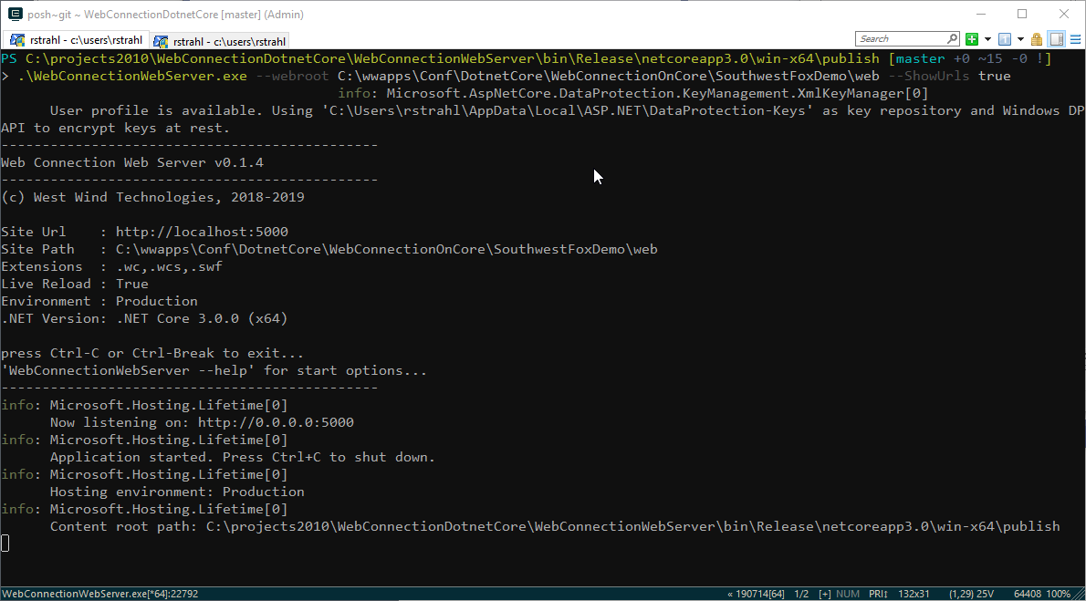
Web Connection on .NET Core
Implemented as Middleware
Shifted .NET Handler code base to Middleware
90% of the code base was portable
The rest was the plumbing hookup code
Standalone Web Server
Implemented as Dotnet Tool
Or as Self Contained EXE (no dependencies)
Server can be hosted in IIS
Supports 64 bit server operation
Development Server Enhancements
Self contained – no IIS dependency
Can be run from the Command Line
Includes built-in Live Reload functionality
Built-in Live Reload Server
Compatible with IIS hosting
Use DevServer during dev, host full .NET for live
Or host Middleware server directly with IIS

Slide 45
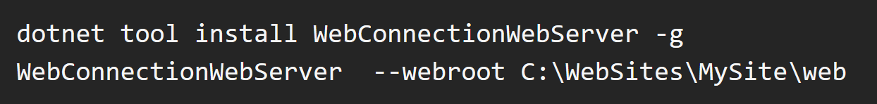
Web Connection Web Server
Installable as a Dotnet Tool
Or run as a (large) Standalone Executable
Can run as a standalone Exe
Can run as an IIS hosted .NET Core handler
Standalone server is large (~50mb)
But: Has no external dependencies

Slide 46
Summary
.NET Core is a Modern Platform
High Performance
Cross Platform
.NET Core is Different, yet Similar
Architecturally different from Full Framework
But uses same .NET base libraries you may already know
ASP.NET Core has many changes, but same concepts
Upgrading to .NET Core requires a bit of work
.NET Core is Microsoft’s Future
.NET Full Framework is done at version 4.8
All new development goes into .NET Core
4.8 will be supported for a long time!!!

Slide 47
Summary
ASP.NET Core and FoxPro don’t mix
No STA Threading Support
Async code and MTA can’t marshal FoxPro objects
Web Connection supports .NET Core via custom Threading
COM is supported in .NET
You can create FoxPro COM objects in .NET
COM Interop for .NET object invocation is broken
But you can use wwDotnetBridge to access .NET Core Components

Slide 48
Thank you!
Resources
Github: Source Code, White Paper and Slides https://github.com/RickStrahl/SWFOX2019_DotnetCore
Contact Rick
@RickStrahl on Twitter
https://weblog.west-wind.com
https://west-wind.com/wconnect/weblog/
rstrahl@west-wind.com

